Slide 1
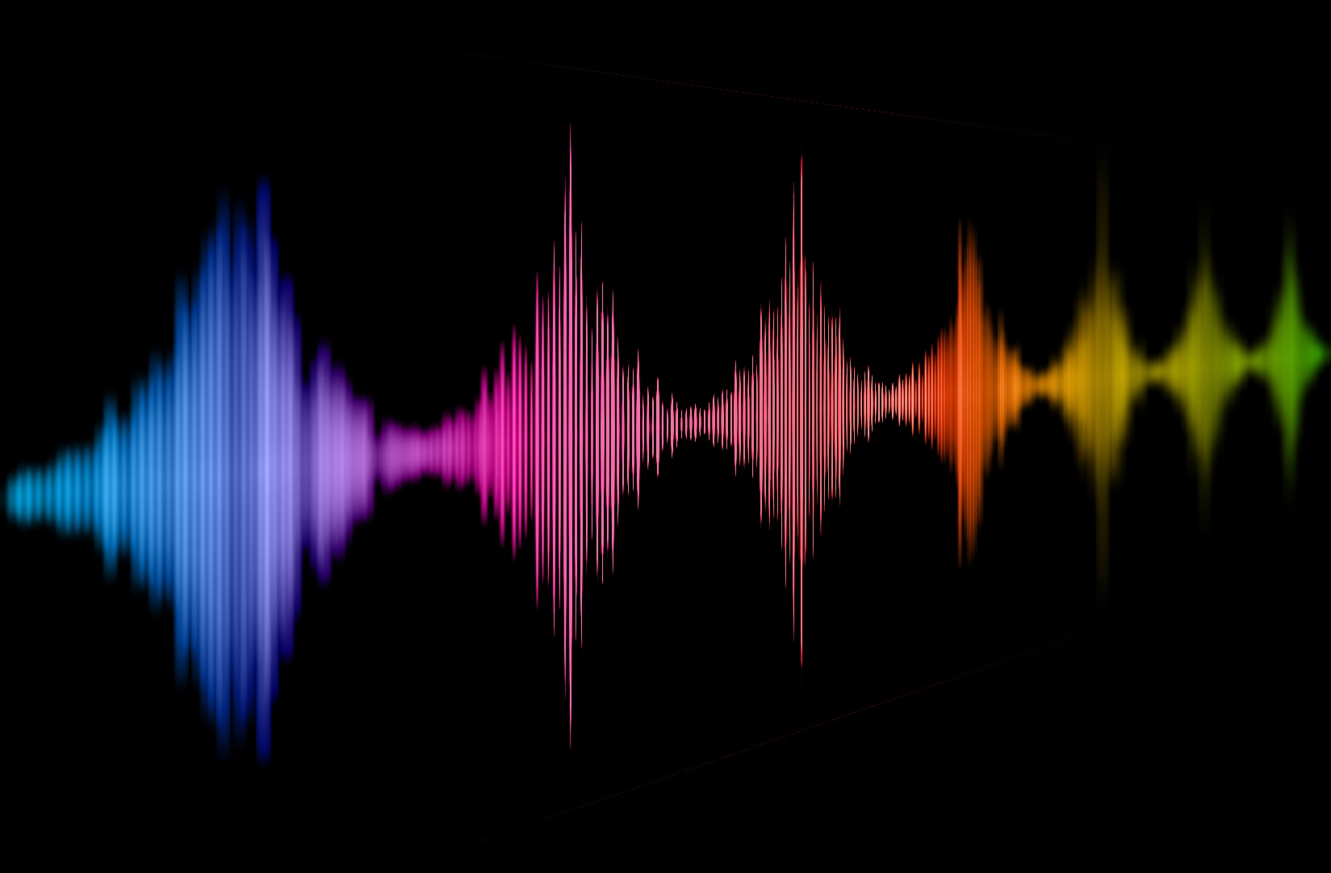
Naturalness of voices - how humans and artificial agents could learn from one another
Christine Nussbaum
Voice Research Unit, 16.02.2024
Voice Naturalness
Notes:
Provocative title
I want to tell you a story (sorry if its still a bit chaotic) and I want to convince you of my mission
Mission: naturalness is something we talk about -> we should strive for a systematic understanding (pooling insight from all available angles)
Human voice perception can help to understand artificial voice perception and vice versa

Slide 2
Motivation
“Impairments in speech naturalness can lead to communication partners perceiving the affected individuals as unhappy, cold, withdrawn, introverted, or bored. These false perceptions can interrupt participation in regular life roles, leading to loss of employment and independence. Thus, impaired speech naturalness can result in social isolation, reduced quality of life, and depression.” (Stepp & Voijtech, 2019)
“The growing popularity of speech interfaces goes hand in hand with the creation of synthetic voices that sound ever more human. Previous research has been inconclusive about whether anthropomorphic design features of machines are more likely to be associated with positive user responses or, conversely, with uncanny experiences. To avoid detrimental effects of synthetic voice design, it is therefore crucial to explore what level of human realism human interactors prefer and whether their evaluations may vary across different domains of application.” (Schreibelmayer & Mara, 2022)
“It is like my toaster is speaking to me.” (Kühne et al. 2020)
Notes:
Because it simply affects how we interact with the voice (or the source of that voice)

Slide 3
Abstract
Perceived naturalness of a voice is a prominent feature which affects our interaction with both human and artificial agents. Despite its importance, (a) conceptual underspecification, (b) inconsistent operationalization, (c) a lack of exchange between research on human and synthetic voices and (d) insufficient anchoring in voice perception theory has precluded a systematic understanding of voice naturalness. In this work, we reflect on the current insights into voice naturalness by pooling evidence from a wider interdisciplinary literature. Against that backdrop, we develop a concise definition of naturalness and propose a conceptual framework rooted both in empirical findings and theoretical models. Subsequently, we identify core gaps in our current understanding of voice naturalness and discuss different approaches for future research.
Notes:
- I should start with my motivation
- stimulus examples from Papers I am going to present today

Slide 4
Current problems:
Conceptual underspecification
Inconsistent operationalization
Lack of exchange between different research domains
Insufficient anchoring in voice perception theory
Precluded a systematic understanding of vocal naturalness
Impeded the visibility of this research to a wider readership
Has kept us from asking some crucial research questions
Has led to a divergence between theory and practise

Slide 5
Introduction – voice naturalness (450)
Current Problems (800)
Conceptual Underspecification (300)
Inconsistent Operationalization (200)
Lack of exchange between different research domains (150)
Insufficient anchoring in voice perception theory (150)
Proposition of a concise framework for voice naturalness (900)
Definitions of naturalness (500)
Differentiation from other concepts (400)
Progressing in conjunction (400)
Naturalness research rooted in voice perception theory (400)
Open questions and future/outlook (400)

Slide 6
Conceptual Challenges and Operationalization
Notes:
- Defining naturalness is already a tough challenge

Slide 7
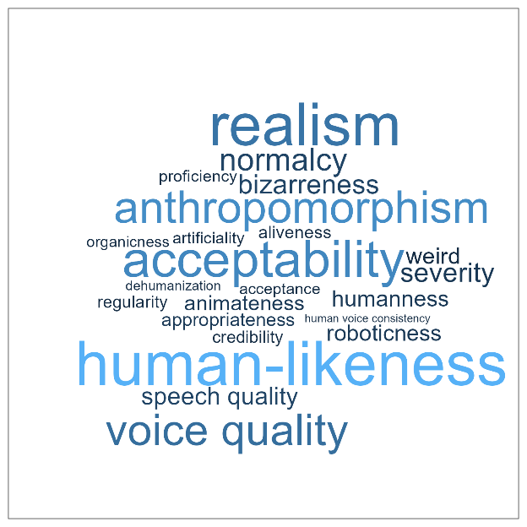
Voice Naturalness
pathological human voices
manipulated human voices
synthesized/artificial voices
“Naturalness was defined as conforming to the listener’s standards of rate, rhythm, intonation, and stress patterning […] ” [e.g. Yorkston et al. 1990]
“Natural speech is the speech most closely perceived as a human voice“ [e.g. Mawalim et al. 2022]
"By naturalness, we understand the voice stimulus to be perceived as a plausible outcome of the human speech production system.“ [Nussbaum et al. 2023]

Slide 8

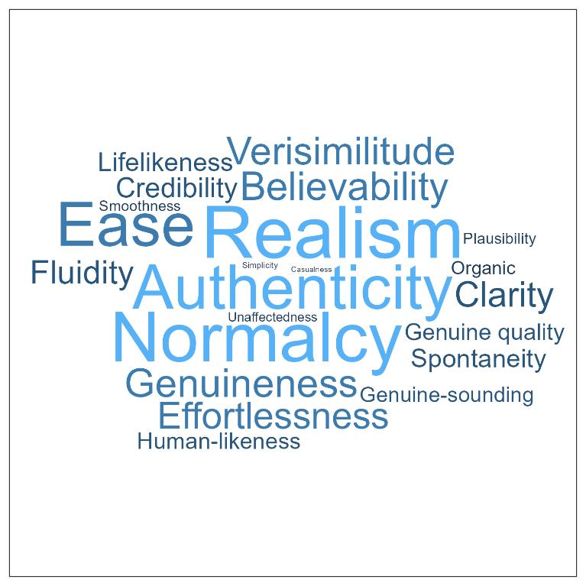
Naturalness Papers
ChatGPT

Slide 9
Challenges with operationalization
How naturalness is explained to the listener (what they should attend to)
Reliability of measurements
The
appropriate scale
The precise properties of the voice material
Potential
confounds
Insufficient report of empirical details
Notes:
Listeners: trained, experts, lay persons
Ratings: direct magnitude estimation (DME) and equal-appearing interval (EAI) scaling
Diverse operationalization would be amazing to compare effects across studies -> but thats not possible
Always… provide stimulus examples

Slide 10
Lack of exchange and insufficient anchoring in voice perception theory
Notes:
- Defining naturalness is already a tough challenge

Slide 11
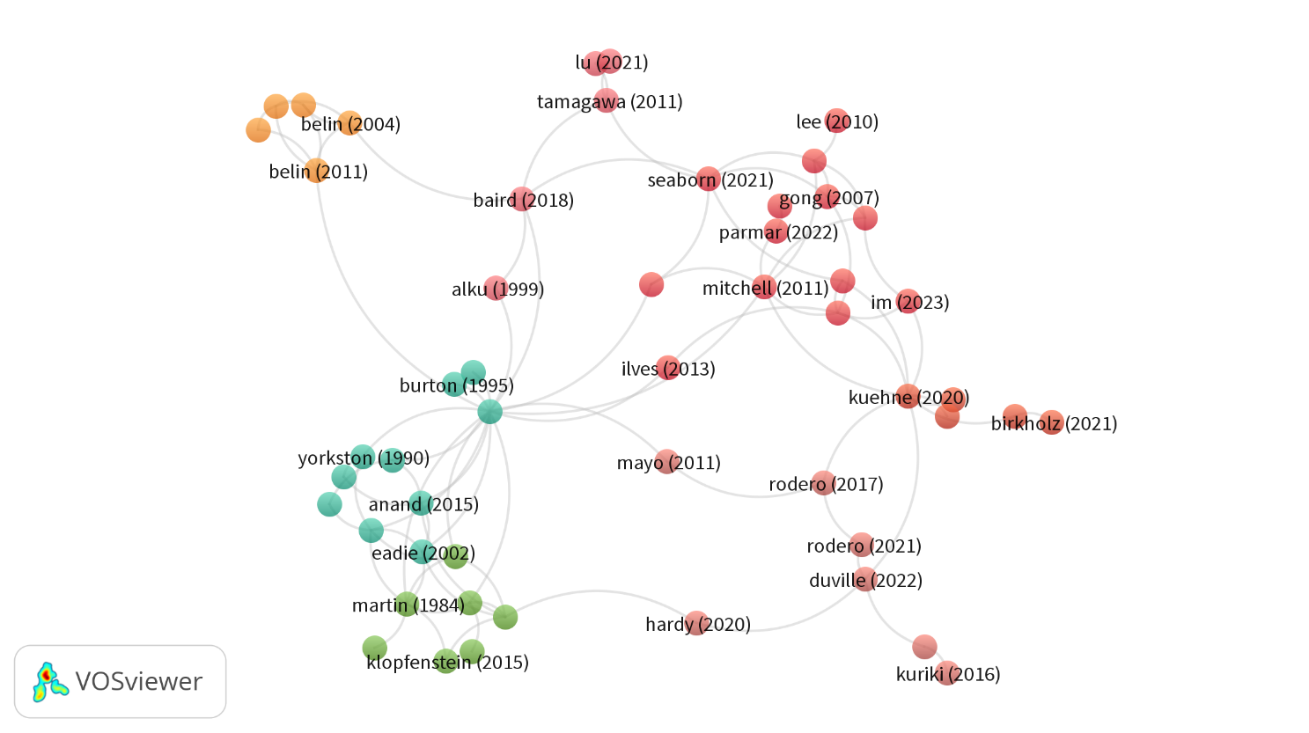

Slide 12
Box 1: A field in numbers (mini literature review)
Literature search (26.04.2024): naturalness AND voice + human-likeness AND voice + cited references
Inclusion criteria:
Naturalness/Human-likeness was either measured or manipulated
Language: English
Published in journal or conference contribution
Human performance/perception data
Quantitative empirical analysis
OR integrative works of such works
Spoken voice (no singing) -> to be discussed
Preprint? -> to be discussed
Research paper (not presentation of a dataset)
-> 66 paper

Slide 13
Box 1: A field in numbers (mini literature review)
Year range (objective)
Voice type: synthetic, human-pathological, human-manipulated, mixture (semi-objective)
Use Naturalness or synonyms in keywords (semi-objective)
Rating data, performance measures, neuronal measures (objective)
Provide an explicit definition of naturalness (objective)
Use which kind of conceptualization from our framework (subjective)
Citations (objective)
Synonyms for naturalness (subjective)

Slide 14
A concise framework for voice naturalness

Slide 15
(1) Human-likeness-based naturalness
(2) Deviation-based naturalness
Human-likeness i.e. resemblance to real human voice
Deviation from an exemplar/reference/ expectation/model that represents maximum naturalness
Conceptualization
„Does this voice sound like a real human speaker?“
Example definitions for participants or readers
“Does this voice sound distorted?”/ “Does this voice sound untypical/rare/
unexpected?”
Notes:
Mostly across human category, presuppose something beyond human voices (Category of human vs. Non-human, even though transition may be continous)
Mostly within human category, for both human and non-human voices (does not need explicit definition of any categories, but can)
-> its not about the empirical realization, it‘s about the underlying conceptual framework, 1 assumes any kind of category boundary, 2 does not
-> compared to distinct emotions vs. Dimensions
Assumptions can be empirically tested
1 can be seen as a special case of 2
Another advantage: they are intuitive and easy to understand
Beyond: manipulated, synthezised, artificial

Slide 16
Differentiation from other concepts
Distinctiveness / Typicality
Voice Pathology
Authenticity/Genuineness
…to be discussed!
Notes:
-> definition is implict by the stimulus material used
Mixture: synthesized voice studies (e.g. vocoder and then they tweek parameters to understand their impact on voice perception)

Slide 17
Progressing in conjunction and rooted in voice perception theory

Slide 18
Box 2: Recommendations
Offer a concise definition to both readers as participants of studies
USE PROPER KEYWORDS to make research findable (Recommendations: Naturalness OR Human-likeness)
Full report of everything, especially reliability, instructions to listeners and acoustic manipulation/measurements
Wherever possible provide stimulus examples (auditory impression simply tells you more than just acoustic measurements and descriptions)
(bridging different publication culture, different scientific standards etc).
Keep the wide readership in mind (very interdisciplinary field), avoid very technical jargon
Notes:
N = 61 studies (of 84)

Slide 19
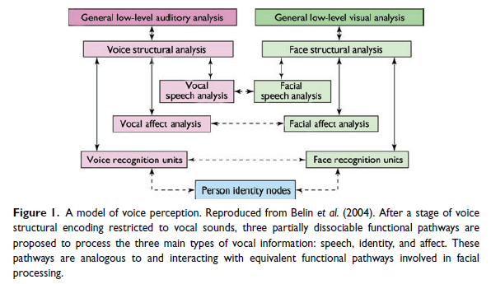
Understanding voice perception
Belin et al (2011)

Slide 20
Understanding voice perception
Are voices special?
Are human voices special?
Are natural voices special?
Are healthy voices special?
Notes:
Voices recruit networks/recourses in the brain that are not recruited by other tyes of acoustic stimuly
What happens, when they are no longer natural/human?
Trying to understand the impact of naturalness on perception is trying to understand what makes voices special

Slide 21
(1) Human-likeness-based naturalness
(2) Deviation-based-naturalness
Human-likeness i.e. resemblance to real human voice
Deviation from an exemplar/reference/ expectation/model that represents maximum naturalness
Conceptualization
Is the perception between human and non-human voices categorical?
Do similar rules/patterns apply to naturalness variation within human voices compared to human/non-human voices?
How does naturalness affect the processing in the brain?
Which role does experience play? / adaptability
Does reduced naturalness due to stimulus manipulation have implications for ecological validity?
Notes:
The reseach questions: do similar regulations/rules/patterns apply to naturalness varition within human voices compared to human/non-human voices
Is human voice/ nonhuman-voice inherently categorical or is this a spectrum?
How to define a non-human voice?
Empirically disentangle the effect of catory vs. the effect of deviation

Slide 22
Additional stuff
Notes:
Main research is not coming from psychology

Slide 23
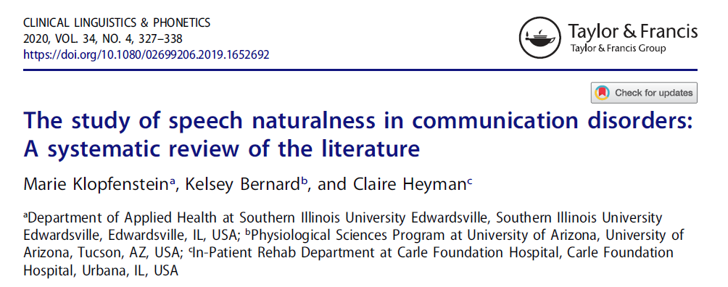
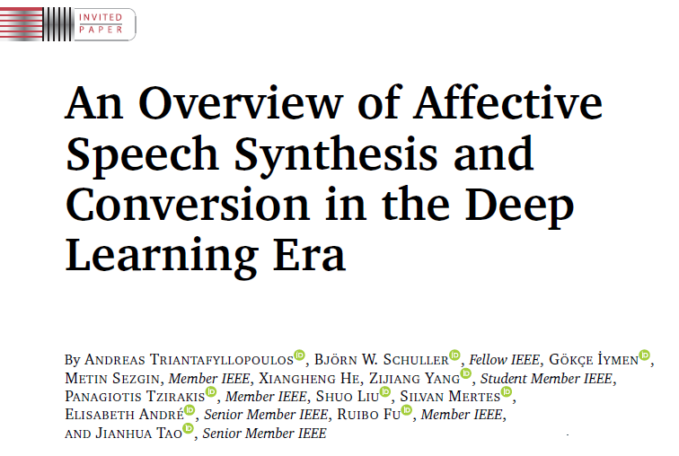
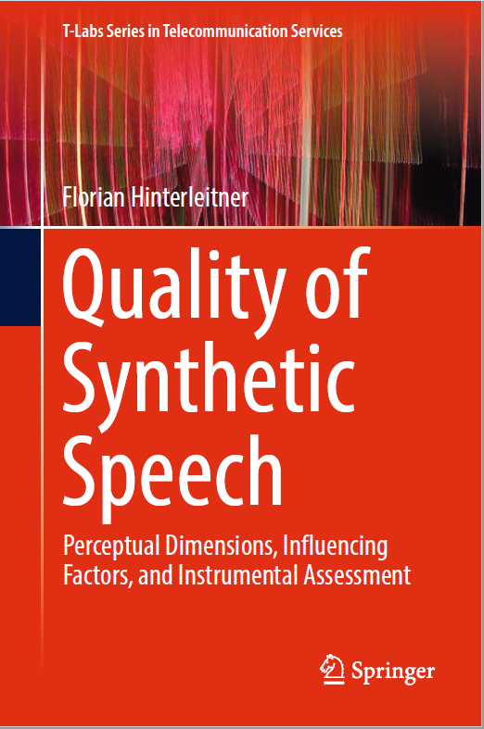
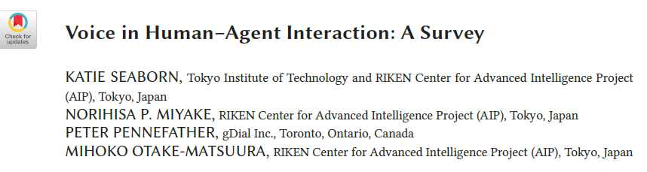
How about any integrative works?
2020
2023
2021
2017
Notes:
Domain specific, but raise good questions and identifiy gaps
Underspecification, reliability, lack of theory, inconsistent terminology
„need to address relationships between naturalness and other variables included in the studies. “

Slide 24
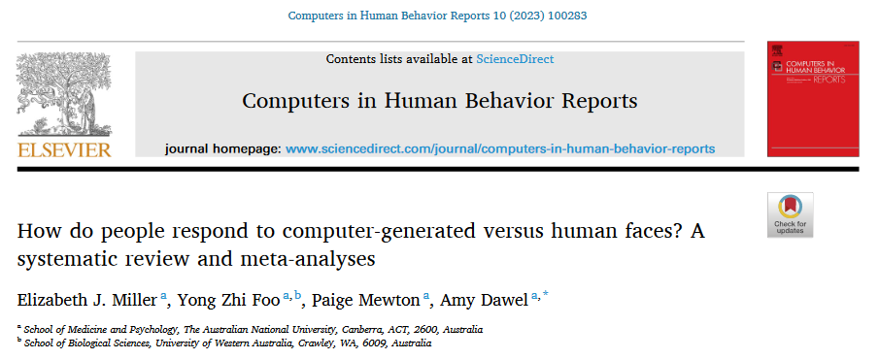
How about any integrative works?
2023

Slide 25
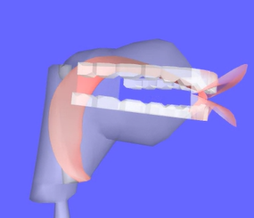
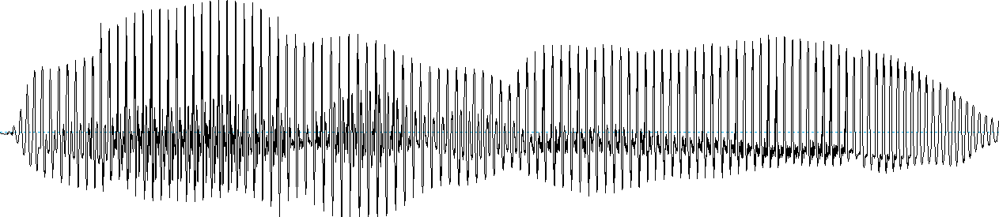
Overview over voice synthesis methods
Concatenative synthesis
Articulatory synthesis
Statistical parametric speech synthesis
Hidden Markov Models
+
Deep Learning Methods
Text-to-Speech (TTS)
https://www.vocaltractlab.de/
https://www.ibm.com/products/text-to-speech
Notes:
Articulatory synthesis: models for the movement of lips, tongue, glottis, and vocal tract
Concatenative synthesis: where the target utterance is constructed from a set of prerecorded building blocks: words, syllables, half-syllables, phonemes, diphones, or triphones
Statistical parametric synthesis: a machine/network is trained on speech data and this information is then fed to a vocoder

Slide 26
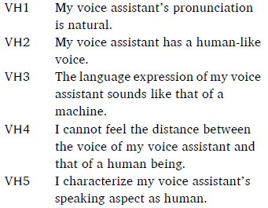
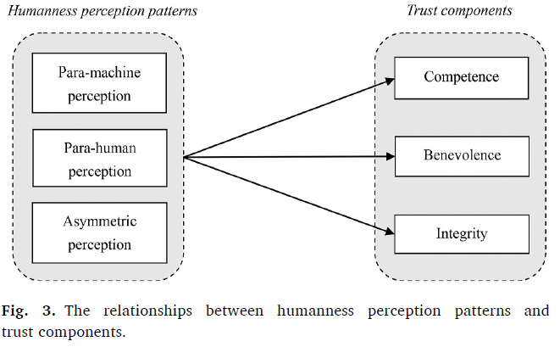
Interindividual differences (Hu, 2021)
Dual humanness:
voice humanness perception reflecting perceived humanness
understanding humanness concerning the listening aspect
“Surprisingly,we do not find a perception pattern exhibiting moderate evaluation on voice humanness and understanding humanness. The absence of this profile suggests that perceived humanness may not be a continuum, but rather be dichotomous, in users’ mind.listening aspect of conversation AI.” (p. 11)
Notes:
Third, for users who have a para-machine perception regarding conversational AI, their levels of trust in conversational AI are surprisingly not the lowest among the discovered perception patterns. Instead, users who possess an asymmetric perception pattern show the lowest morality-based trust. This finding suggests that the asymmetry between humanness perceptions on the speaking and listening of conversational AI may leads users to question the ethics of their conversational AIs.
Kuriki 2016: people without ASD: difference in naturalness, with ASD: none (robot affinity)
Lee (2010): naturalness-effect only for intuitive and less analytical participants (played a game with a robot)
Schreibelmayer (2022): listeners openness affects human-likeness preference

Slide 27
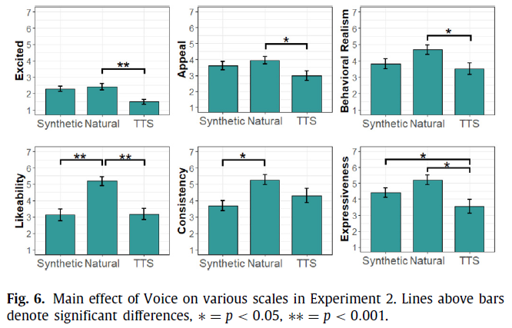
Higgins et al. (2022)
Notes:
- smoothing of pitch cues via Tandem-STRAIGHT, they manipulated naturalness of human recordings, but not manipulation check

Slide 28
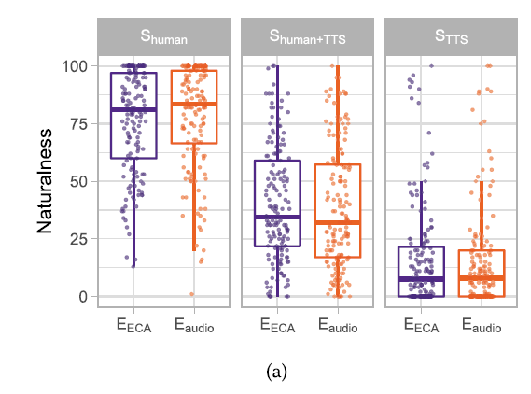
Ehret et al. (2021)
Notes:
"(1) inadequate prosody, as generated by off-the-shelf text-to-speech (TTS) engines with synthetic output; (2) the same inadequate prosody imitated by trained human speakers; and (3) adequate prosody produced by those speakers"

Slide 29
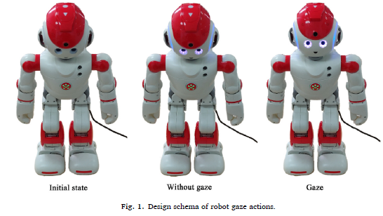
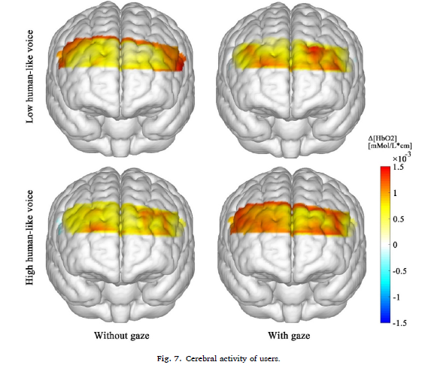
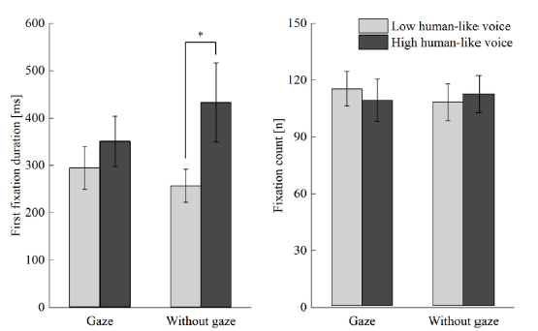
Brain data (Li et al 2023)
Notes:
Congruency effect

Slide 30
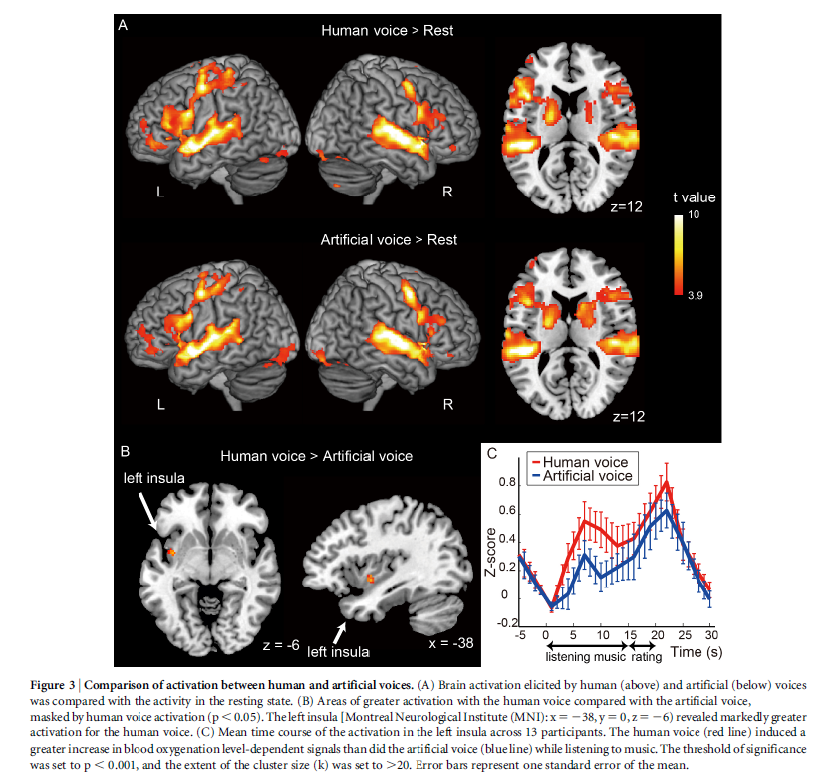
Brain data (Tamura et al 2015)
Notes:
MRI: significantly higher activation in the left posterior insula in response to human voices than in response to artificial voices
Singing voices

Slide 31
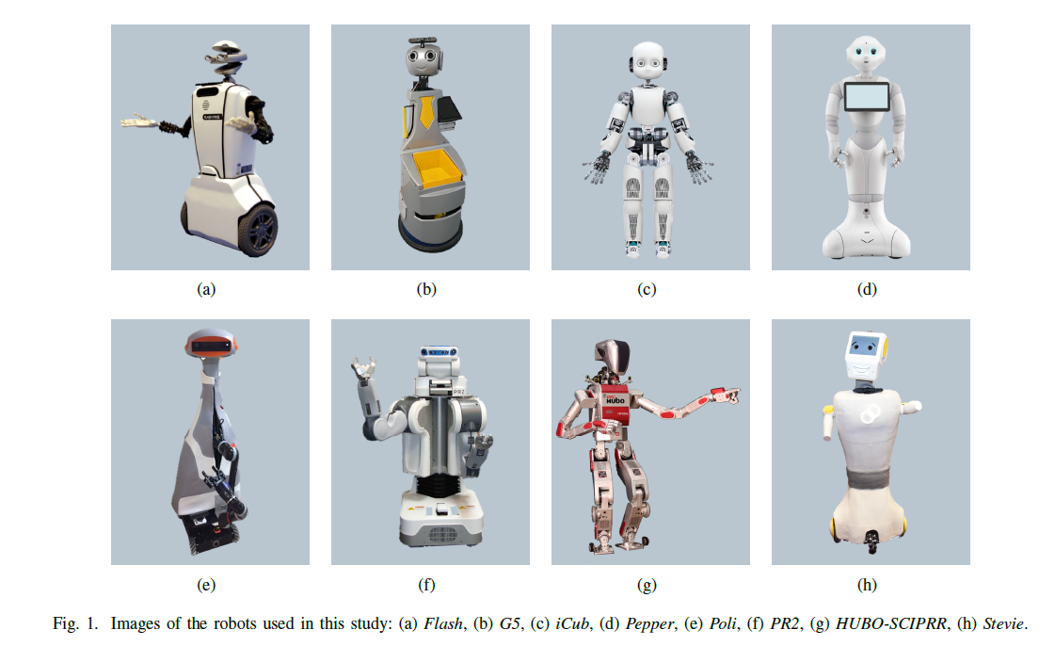
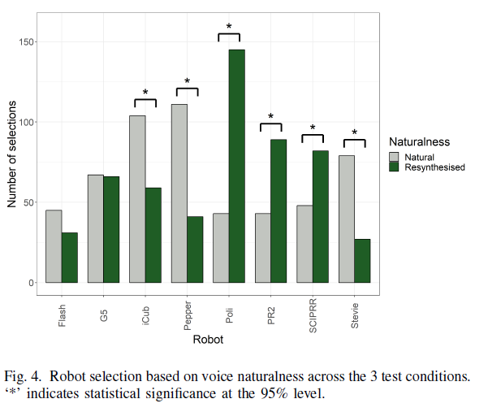
Multimodal agent perception (McGinn and Torre 2019)
Notes:
- People match human-like voices with more human-like robots

Slide 32
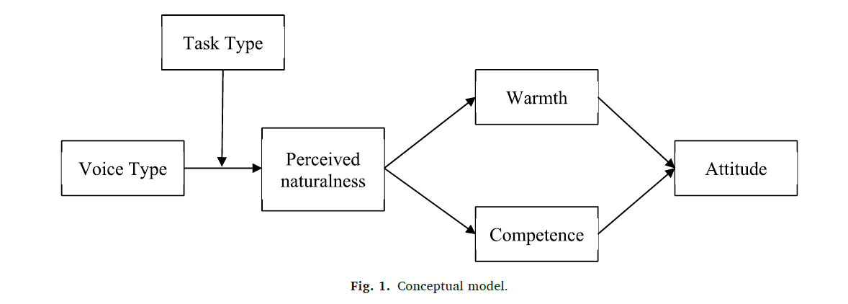
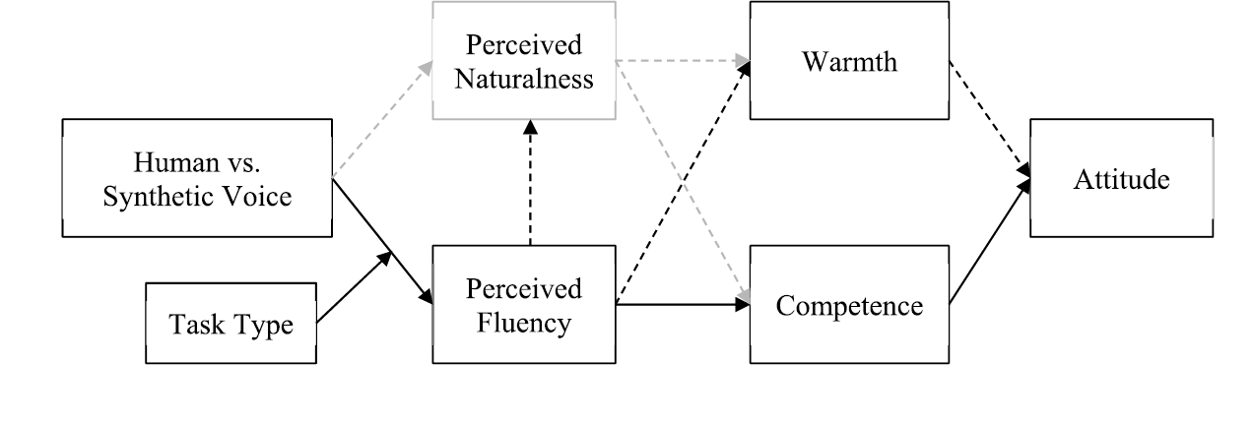
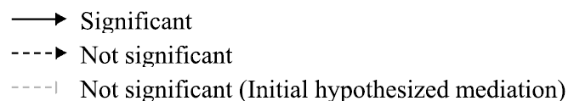

Is naturalness always better? – not necessarily (Im 2023)
"The findings imply that VAs should not be designed to closely resemble humans.
Rather, consideration of usage contexts and consumer expectations should be prioritized in developing most
likable VAs.“ (Im 2023)
Notes:
Baird 2018: linked to likeability
"The findings imply that VAs should not be designed to closely resemble humans.
Rather, consideration of usage contexts and consumer expectations should be prioritized in developing most
likable VAs.“ (Im, 2023)

